Slide 1
VoIP Network Design for Private Company Limited
PRESENTED BY:
Mst Monira Khatun
ID:222400019
Course title: Computer Networks Lab
Course code: CSE 416
PRESENTED TO:
Momtaj Hossain Mow(Lecturer)
Department of Computer Science & Engineering

Slide 2

Introduction
I have designed a VoIP-enabled network for Private Company Limited using Cisco Packet Tracer. The goal was to interconnect four departments — ICT, Finance, HR, and Sales — with support for voice and data communication across all locations.

Slide 3
Project Objectives
Build a scalable and secure VoIP network
Use Cisco devices (2811 routers, 2960 switches)
Provide dynamic IP addressing
Enable remote access, inter-VLAN routing, and OSPF routing
Configure VoIP dial plans and dial-peer communication

Slide 4
Network Structure
4 Routers (Cisco 2811), one for each department
4 Switches (Cisco 2960)
4 Servers in the ICT department (DHCP, DNS, Email, HTTP)
Each PC is connected through an IP Phone
Router-to-router connections use serial cables

Slide 5
IP Addressing Scheme
Data VLAN | 192.168.100.0/24
Voice VLAN | 172.16.100.0/24
Router Links | 10.10.100.0/24
Purpose
IP Network
Each department is divided into:
VLAN 10 for data
VLAN 100 for voice (IP Phones)

Slide 6
Device Configuration
Hostnames and passwords set for all routers
Banner messages and password encryption enabled
Domain lookup disabled
SSH configured for secure remote access

Slide 7
VLANs and Inter-VLAN Routing
VLAN 10: Data | VLAN 100: Voice
Router-on-a-stick used for inter-VLAN routing
Subinterfaces created on routers (e.g., Fa0/0.10, Fa0/0.100)
VLANs mapped to respective ports on the switches

Slide 8

DHCP Configuration
DHCP Server (ICT) assigns IPs to all PCs (Data VLAN)
Each departmental router provides DHCP to its IP phones (Voice VLAN)

Slide 9

VoIP & Dial Plan
VoIP enabled using telephony-service on routers Each phone is assigned a directory number
Dial plans configured by department:
Finance: 1..
HR: 2..
Sales: 3..
ICT: 4..

Slide 10
Routing Configuration
OSPF Area 0 used for routing between departments
All networks advertised using the network command
Ensures full connectivity between routers

Slide 11
Dial-Peer Configuration
Dial-peer voice commands configured on each router
Allows phones from different departments to communicate
Example: Dial 201 from Finance to reach HR

Slide 12

Testing & Verification
All PCs received dynamic IPs via DHCP
IP phones registered and received voice IPs
Successful pings across VLANs
VoIP calls tested between departments
SSH access to routers verified

Slide 13
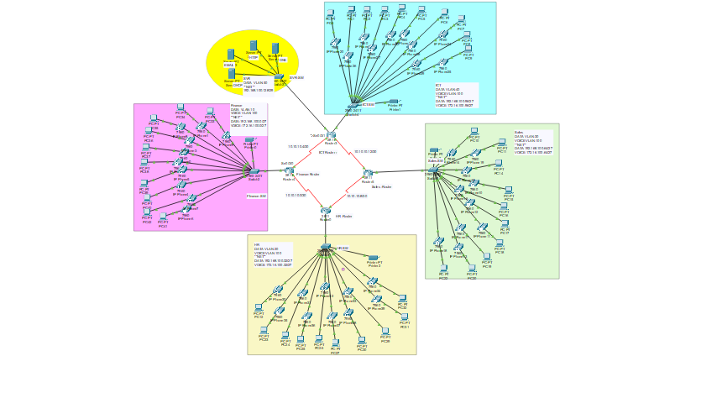
Final look

Slide 14
Conclusion
Network meets all business and technical requirements
Supports data and voice communication
Ensures security, scalability, and remote management
All features tested and working correctly

Slide 15

Conclusion
Network meets all business and technical requirements
Supports data and voice communication
Ensures security, scalability, and remote management
All features tested and working correctly

